Slide 1
CS F222: Discrete Structures
for
Computer Science
Topic: Set Theory and Functions
Dr. Raghunath Reddy

Slide 2
Introduction to Set Theory
A set is an unordered collection of distinct objects, called elements or members of the set.
Often, but not always, the objects in a set have similar properties.
Many important discrete structures are built using sets, which are collections of objects.
Combinations; unordered collections of objects used extensively in counting;
Relations, sets of ordered pairs that represent relationships between objects;
graphs, sets of vertices and edges that connect vertices; and
finite state machines, used to model computing machines
Notation:
For sets, we’ll use variables S, T, U, … (Upper case letters) For elements, we’ll use variable x, y, z (lower case letters)

Slide 3
Representations of Sets
Roster Method: We can denote a set S in writing by listing all of its elements in curly braces:
{a, b, c} is the set of whatever 3 objects are denoted by a, b, c.
Set builder notation: For any proposition P(x) over any universe of discourse, {x | P(x)} is the set of all x such that P(x).
Ex: O = { x | x is an odd positive number less than 10}

Slide 4
Basic properties of sets
Sets are inherently unordered:
No matter what objects a, b, and c denote, {a, b, c} = {a, c, b} = {b, a, c} = {b, c, a} = {c, a, b} = {c, b, a}.
All elements are distinct (unequal);
multiple listings make no difference!
If a=b, then {a, b, c} = {a, c} = {b, c} = {a, a, b, a, b, c, c, c, c}.
This set contains only 2 elements!

Slide 5
Set Equality
Two sets are equal if and only if they contain exactly the same elements.
In particular, it does not matter how the set is defined or denoted.
For example: The set {1, 2, 3, 4} = {x | x is an integer where x>0 and x<5 } = {x | x is a positive integer whose square is >0 and <25}

Slide 6
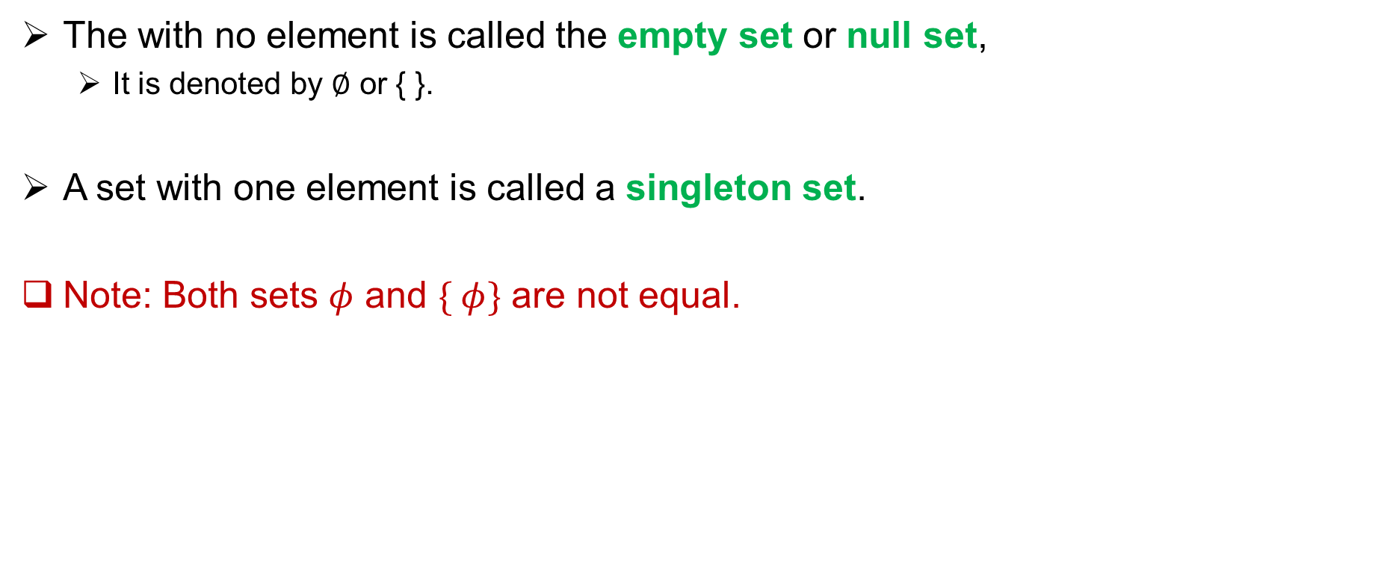
Empty Set and Singleton Set
The with no element is called the empty set or null set,
It is denoted by ∅ or { }.
A set with one element is called a singleton set.
Note: Both sets $φ$ and $\{ φ\}$ are not equal.

Slide 7
Basic Set Relations: Member of
a ∈ A : a is an element of the set A. a ∉ A : a is not an element of the set A.
Remark: We can define set equality in terms of ∈ relation:
∀S,T: S=T ↔ (∀x: x∈S ↔ x∈T)
Venn diagram:

Slide 8
Subset and Superset Relations
The set A is a subset of B, (and B is a superset of A),
if and only if every element of A is also an element of B.
Notation A ⊆ B to indicate that A is a subset of the set B and, B ⊇ A denotes B is a superset of A
S⊆T ⇔ ∀x (x∈S → x∈T)
Results: For any set S, ∅⊆S and S⊆S.
Notes:
Discrete Mathematics and its Applications
9/15/2021
(c)2001-2002, Michael P. Frank
8

Slide 9
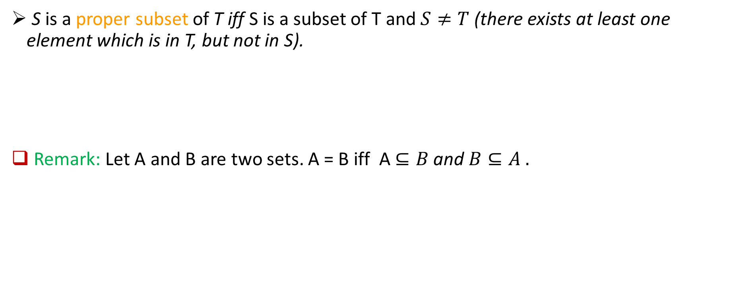
Proper (Strict) Subsets
S is a proper subset of T iff S is a subset of T and $S≠T$ (there exists at least one element which is in T, but not in S).
Remark: Let A and B are two sets. A = B iff A $⊆B$ and $B⊆A .$
Notes:
Discrete Mathematics and its Applications
9/15/2021
(c)2001-2002, Michael P. Frank
9

Slide 10
Sets as Objects
Sets may have other sets as members.
For instance, we have the sets
A = {∅, {a}, {b}, {a, b}} and B = {x ∣ x is a subset of the set {a, b}}.
Note that a ≠ {a} ≠ {{a}} !!!!
Notes:
Discrete Mathematics and its Applications
9/15/2021
(c)2001-2002, Michael P. Frank
10

Slide 11
Cardinality and Finiteness
|S| (read “the cardinality of S”) is a measure of how many different elements S has.
E.g., |∅|=0, |{1,2,3}| = 3, |{a,b}| = 2,
|{{1,2,3},{4,5}}| = ____
If |S | is a non-negative integer, then we say S is finite. Otherwise, we say S is infinite.

Slide 12
Power set
The power set P(S) of a set S is the set of all subsets of S. P(S) :≡ {x | x⊆S}.
Sometimes P(S) is written 2^{S}.
E.g. P({a,b}) = {∅, {a}, {b}, {a,b}}.
What is the power set of empty set ?
Let |S|=n, then the size of the power set of S is ……………

Slide 13
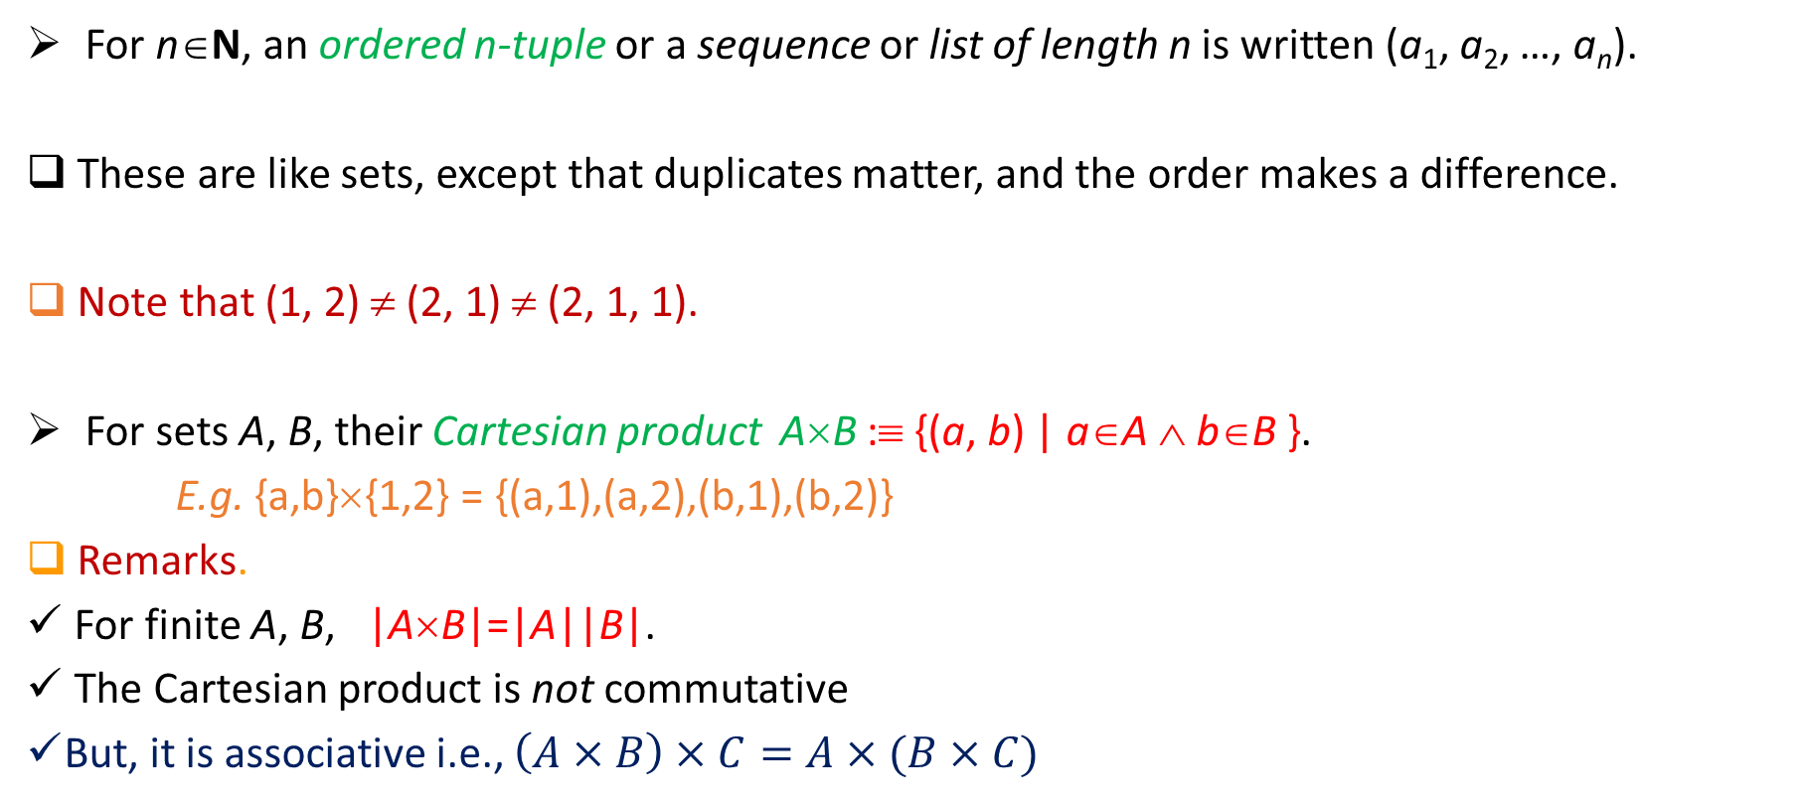
Ordered n-tuples and Cartesian Product
For n∈N, an ordered n-tuple or a sequence or list of length n is written (a₁, a₂, …, a_{n}).
These are like sets, except that duplicates matter, and the order makes a difference.
Note that (1, 2) ≠ (2, 1) ≠ (2, 1, 1).
For sets A, B, their Cartesian product A×B :≡ {(a, b) | a∈A ∧ b∈B }.
E.g. {a,b}×{1,2} = {(a,1),(a,2),(b,1),(b,2)}
Remarks.
For finite A, B, |A×B|=|A||B|.
The Cartesian product is not commutative
But, it is associative i.e., $\left(A×B\right)×C=A×(B×C)$
Notes:
Discrete Mathematics and its Applications
9/15/2021
(c)2001-2002, Michael P. Frank
13

Slide 14
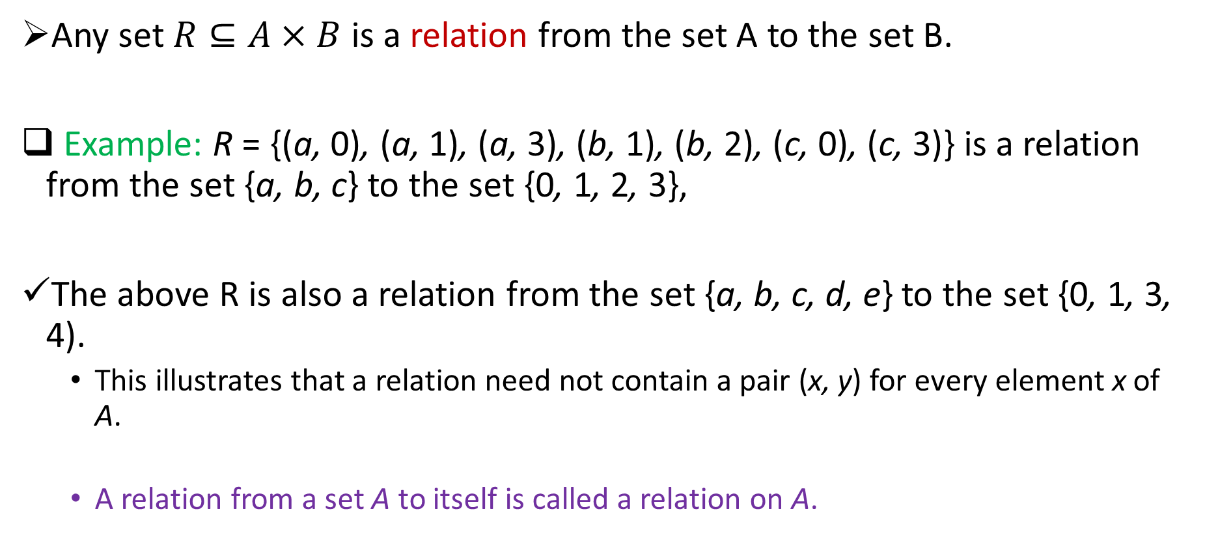
Relations
Any set $R⊆A×B$ is a relation from the set A to the set B.
Example: R = {(a, 0), (a, 1), (a, 3), (b, 1), (b, 2), (c, 0), (c, 3)} is a relation from the set {a, b, c} to the set {0, 1, 2, 3},
The above R is also a relation from the set {a, b, c, d, e} to the set {0, 1, 3, 4).
This illustrates that a relation need not contain a pair (x, y) for every element x of A.
A relation from a set A to itself is called a relation on A.

Slide 15
Few more examples

Slide 16
Set Operators

Slide 17
Union
For sets A, B, their ∪nion A∪B is the set containing all elements that are in A, or in B (or, of course, in both).
Formally, ∀A,B: A∪B = {x | x∈A ∨ x∈B}.
Remark. A∪B is a superset of both A and B
∀A, B: (A∪B ⊇ A) ∧ (A∪B ⊇ B)
Examples:
{a,b,c} ∪ {2,3} = {a,b,c,2,3}
{2,3,5}∪{3,5,7} = {2,3,5,3,5,7} ={2,3,5,7}

Slide 18
Intersection
For sets A, B, their intersection A∩B is the set containing all elements that are in both A and (“∧”) in B.
Formally, ∀A,B: A∩B={x | x∈A ∧ x∈B}.
Remark. A∩B is a subset of both A and B
∀A, B: (A∩B ⊆ A) ∧ (A∩B ⊆ B)
Examples:
{a,b,c}∩{2,3} = ___
{2,4,6}∩{3,4,5} = ______
Two sets A, B are called disjoint (i.e., unjoined) iff their intersection is empty i.e., (A∩B=∅).

Slide 19
How many elements are in A∪B?
|A∪B| = |A| + |B| − |A∩B|
Subtract out items
in intersection, to
compensate for
double-counting them!
Notes:
Discrete Mathematics and its Applications
9/15/2021
(c)2001-2002, Michael P. Frank
19

Slide 20
Set Difference
For sets A, B, the difference of A and B, written A−B, is the set of all elements that are in A but not B.
( Also called: The complement of B with respect to A.)
Formally: A − B :≡ {x | x∈A ∧ x∉B}
Example: {1,2,3,4,5,6} − {2,3,5,7,9,11} =
Notes:
Discrete Mathematics and its Applications
9/15/2021
(c)2001-2002, Michael P. Frank
20

Slide 21
Set Complements
The universe of discourse can itself be considered a set, call it U.
When the context clearly defines U, we say that for any set A⊆U
The complement of A, written , is the complement of A w.r.t. U, i.e., it is U−A.
E.g., If U=N,

Slide 22
Set Identities
How to prove the set identities:
Let E₁ = E₂ (where the Es are set expressions)
Prove E₁ ⊆ E₂ and E₂ ⊆ E₁ separately.
Identity: A∪∅ = A = A∩U
Domination: A∪U = U , A∩∅ = ∅
Idempotent: A∪A = A = A∩A
Double complement:
Commutative: A∪B = B∪A , A∩B = B∩A
Associative: A∪(B∪C)=(A∪B)∪C , A∩(B∩C)=(A∩B)∩C
De Moran’s Law:

Slide 23
Show that A∩(B∪C)=(A∩B)∪(A∩C).
Part 1: Show A∩(B∪C)⊆(A∩B)∪(A∩C).
Assume x∈A∩(B∪C), & show x∈(A∩B)∪(A∩C).
We know that x∈A, and x∈B or x∈C.
Case 1: x∈B. Then x∈A∩B, so x∈(A∩B)∪(A∩C).
Case 2: x∈C. Then x∈A∩C , so x∈(A∩B)∪(A∩C).
Therefore, x∈(A∩B)∪(A∩C).
Therefore, A∩(B∪C)⊆(A∩B)∪(A∩C).
Part 2: Show (A∩B)∪(A∩C) ⊆ A∩(B∪C). …

Slide 24
Generalized Unions & Intersections
Since union & intersection are commutative and associative, we can extend them from operating on ordered pairs of sets (A,B) to operating on sequences of sets (A₁,…,A_{n})

Slide 25
Generalized Union
Binary union operator: A∪B
n-ary union: A∪A₂∪…∪A_{n} :≡ ((…((A₁∪ A₂) ∪…)∪ A_{n}) (grouping & order is irrelevant)
“Big U” notation:
or for infinite sets of sets:

Slide 26
Generalized Intersection
Binary intersection operator: A∩B
n-ary intersection: A₁∩A₂∩…∩A_{n}≡((…((A₁∩A₂)∩…)∩A_{n}) (grouping & order is irrelevant)
“Big Arch” notation:
or for infinite sets of sets:

Slide 27
Computer Representations of Sets
For an enumerable u.d. U with ordering x₁, x₂, …, represent a finite set S⊆U as the finite bit string B=b₁b₂…b_{n} where ∀i: x_{i}∈S ↔ (i<n ∧ b_{i}=1).
E.g. Let U={0, 1, 2, 3, 4, 5, 6 7, 8, 9, 10, 11} and S={2,3,5,7,11}, then B=001101010001.
In this representation, the set operators “∪”, “∩”, “‾ “ are implemented directly by bitwise OR, AND, NOT, respectively!
Notes:
Discrete Mathematics and its Applications
9/15/2021
(c)2001-2002, Michael P. Frank
27

Slide 28
Functions

Slide 29
Introduction to Functions
Let A and B be nonempty sets. A function f from A to B is an assignment of exactly one element of B to each element of A.
We write f (a) = b if b is the unique element of B assigned by the function f to the element a of A.
If f is a function from A to B, we write f : A → B.

Slide 30
Some Function Terminology
Let f:A→B, and f(a)=b (where a∈A & b∈B). Then
A is the domain of f.
B is the codomain of f.
b is the image of a under f.
a is a pre-image of b under f.
In general, b may have more than 1 pre-image.
The range R⊆B of f is R={b | ∃a f(a)=b }.

Slide 31
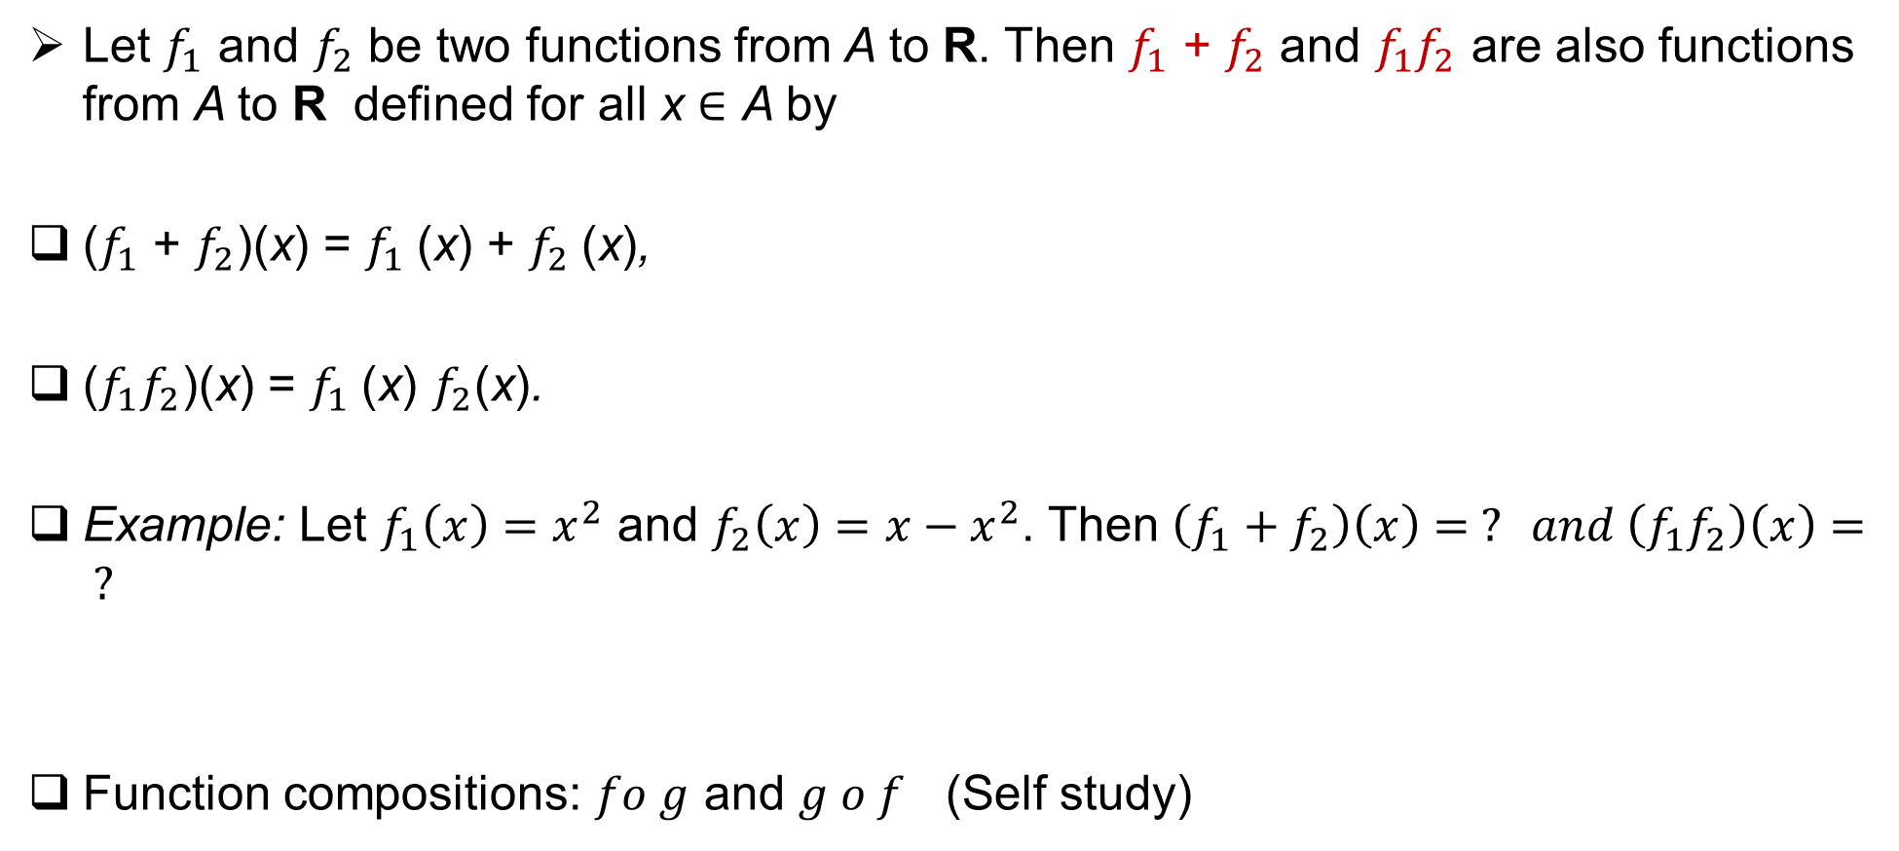
Function Operators
Let $f_{1}$ and $f_{2}$ be two functions from A to R. Then $f_{1}$ + $f_{2}$ and $f_{1}f_{2}$ are also functions from A to R defined for all x ∈ A by
($f_{1}$ + $f_{2}$)(x) = $f_{1}$(x) + $f_{2}$(x),
($f_{1}f_{2}$)(x) = $f_{1}$(x) $f_{2}$(x).
Example: Let $f_{1}\left(x\right)=x^{2}$ and $f_{2}\left(x\right)=x−x^{2}$. Then $\left(f_{1}+f_{2}\right)\left(x\right)= ? and \left(f_{1}f_{2}\right)\left(x\right)= ?$
Function compositions: $fo g$ and $g o f$ (Self study)

Slide 32
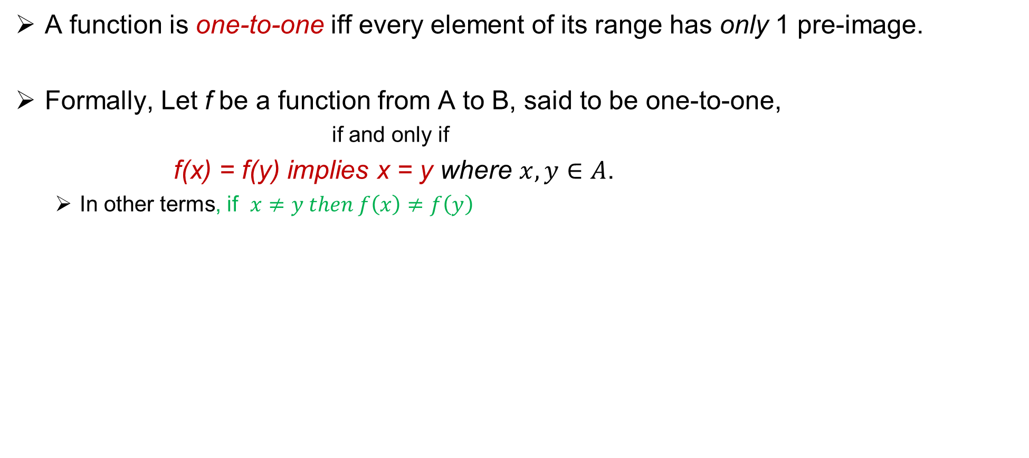
One – to - One (injection or injective) Functions
A function is one-to-one iff every element of its range has only 1 pre-image.
Formally, Let f be a function from A to B, said to be one-to-one,
if and only if
f(x) = f(y) implies x = y where $x, y∈A$.
In other terms, if $x≠y then f\left(x\right)≠f\left(y\right)$

Slide 33
Onto (surjection or surjective) Functions
A function onto iff every element of its codomain has a pre-image.
Formally, A function f from A to B is called onto,
if and only if
for every element b ∈ B there is an element a ∈ A with f (a) = b.

Slide 34
Few more examples

Slide 35
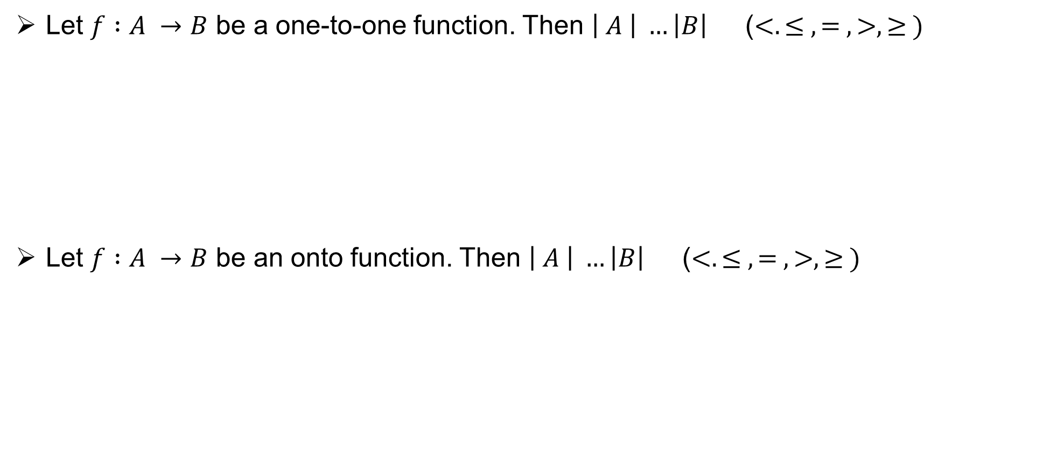
Important observations
Let $f :A →B$ be a one-to-one function. Then $\left| A \right| …\left|B\right|$ ($<. ≤ , = , >, ≥ )$
Let $f :A →B$ be an onto function. Then $\left| A \right| …\left|B\right|$ ($<. ≤ , = , >, ≥ )$

Slide 36
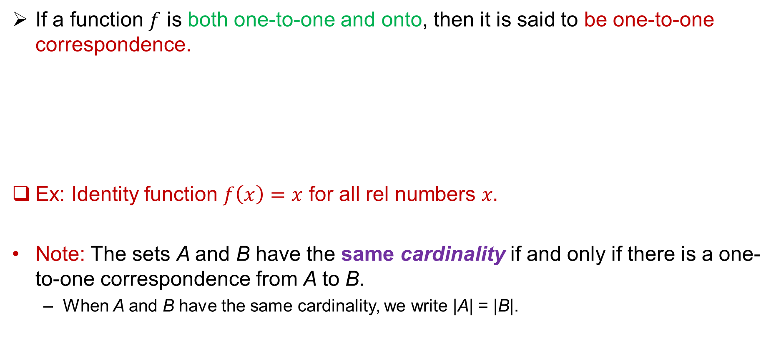
One-to-one Correspondence (Bijection)
If a function $f$ is both one-to-one and onto, then it is said to be one-to-one correspondence.
Ex: Identity function $f\left(x\right)=x$ for all rel numbers $x.$
Note: The sets A and B have the same cardinality if and only if there is a one-to-one correspondence from A to B.
When A and B have the same cardinality, we write |A| = |B|.

Slide 37
Countable
and
Uncountable sets

Slide 38
Countable Sets and Uncountable sets
A set S is said to be countable if it is either
finite or
has the same cardinality as the set of positive integers (i.e., there exists one-to-one correspondence between the set of positive integers and S).
A set which is not countable is called uncountable.

Slide 39
Examples:
The set of odd positive integers is countable.

Slide 40
Examples:
The set of integers is countable.

Slide 41
Countable set properties
An infinite set is countable if and only if it is possible to list the elements of the set in a sequence (indexed by the positive integers).
A sub set of countable set is also countable.

Slide 42
Examples:
The set of positive rational numbers is countable.

Slide 43
Countable set properties
The union of two countable sets is also countable.
Countable union of countable sets is countable.

Slide 44
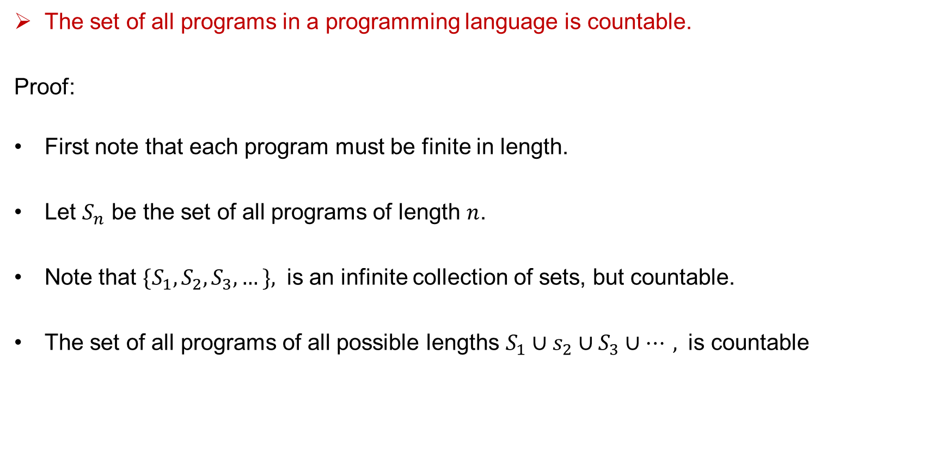
Example on Programs
The set of all programs in a programming language is countable.
Proof:
First note that each program must be finite in length.
Let $S_{n}$ be the set of all programs of length $n$.
Note that ${\{S}_{1},S_{2},S_{3},…\},$ is an infinite collection of sets, but countable.
The set of all programs of all possible lengths $S_{1}∪s_{2}∪S_{3}∪⋯,$ is countable

Slide 45
Example on uncountable set
The set of real numbers is uncountable.

Slide 47
Result (SCHRöDER-BERNSTEIN THEOREM)
If A and B are sets with |A| ≤ |B| and |B| ≤ |A|, then |A| = |B|.
In other words, if there are one-to-one functions f from A to B and g from B to A, then there is a one-to-one correspondence between A and B.

Slide 48
Set Operators

Slide 49
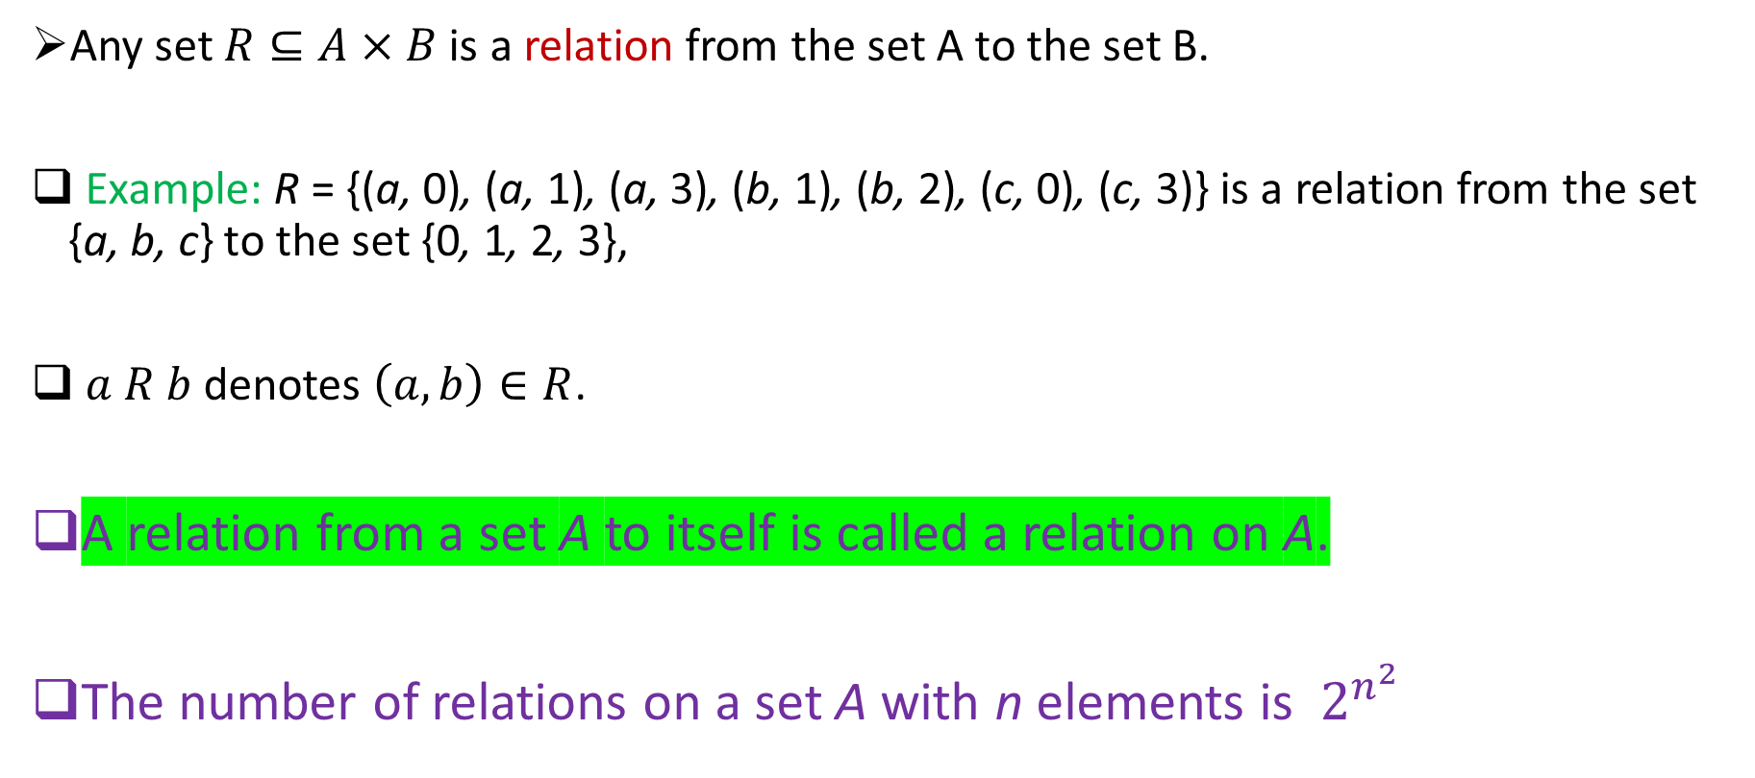
Relations
Any set $R⊆A×B$ is a relation from the set A to the set B.
Example: R = {(a, 0), (a, 1), (a, 3), (b, 1), (b, 2), (c, 0), (c, 3)} is a relation from the set {a, b, c} to the set {0, 1, 2, 3},
$a R b$denotes $\left(a, b\right)∈R$.
A relation from a set A to itself is called a relation on A.
The number of relations on a set A with n elements is $2^{n^{2}}$

Slide 50
Examples:
Let A = {1, 2, 3, 4} be a set. List the order pairs in the relation, defined on A,
R = {(a, b) | a divides b}.

Slide 51
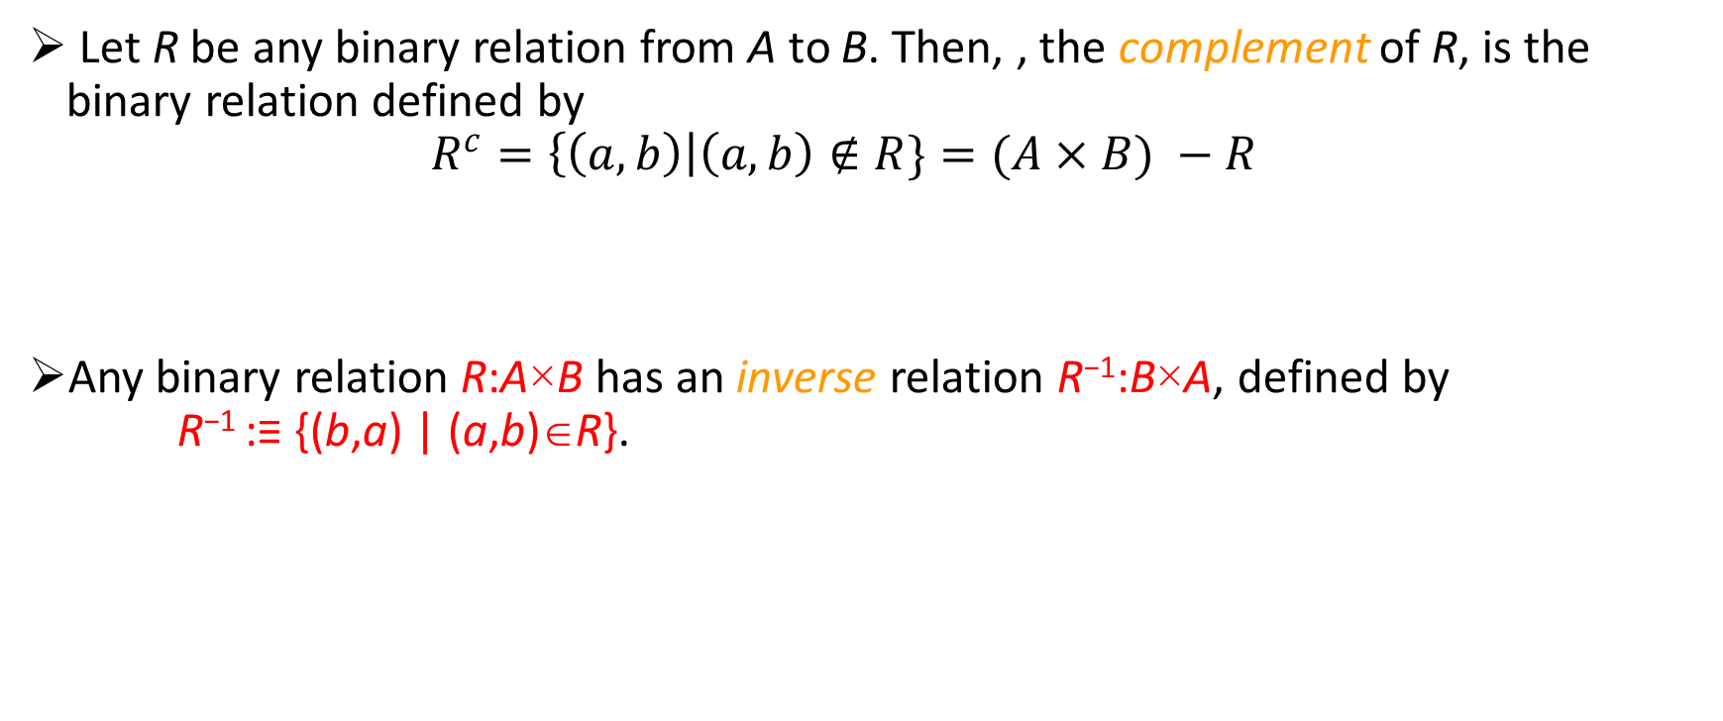
Complementary Relations and Inverse relations
Let R be any binary relation from A to B. Then, , the complement of R, is the binary relation defined by $R^{c}=\left\{\left(a, b\right)\right|\left(a, b\right)∉R\}=(A×B) −R$
Any binary relation R:A×B has an inverse relation R⁻¹:B×A, defined by R⁻¹ :≡ {(b,a) | (a,b)∈R}.

Slide 52
Reflexive relations
A relation R on a set A is called reflexive if (a, a) ∈ R for every element a ∈ A.

Slide 53
Symmetric relations
A relation R on a set A is called symmetric if (b, a) ∈ R whenever (a, b) ∈ R, for all a, b ∈ A.

Slide 54
Antisymmetric relations
A relation R on a set A such that for all a, b ∈ A, if (a, b) ∈ R and (b, a) ∈ R, then a = b is called antisymmetric.

Slide 55
Transitive relations
A relation R on a set A is called transitive if whenever (a, b) ∈ R and (b, c) ∈ R,
then (a, c) ∈ R, for all a, b, c ∈ A.

Slide 56
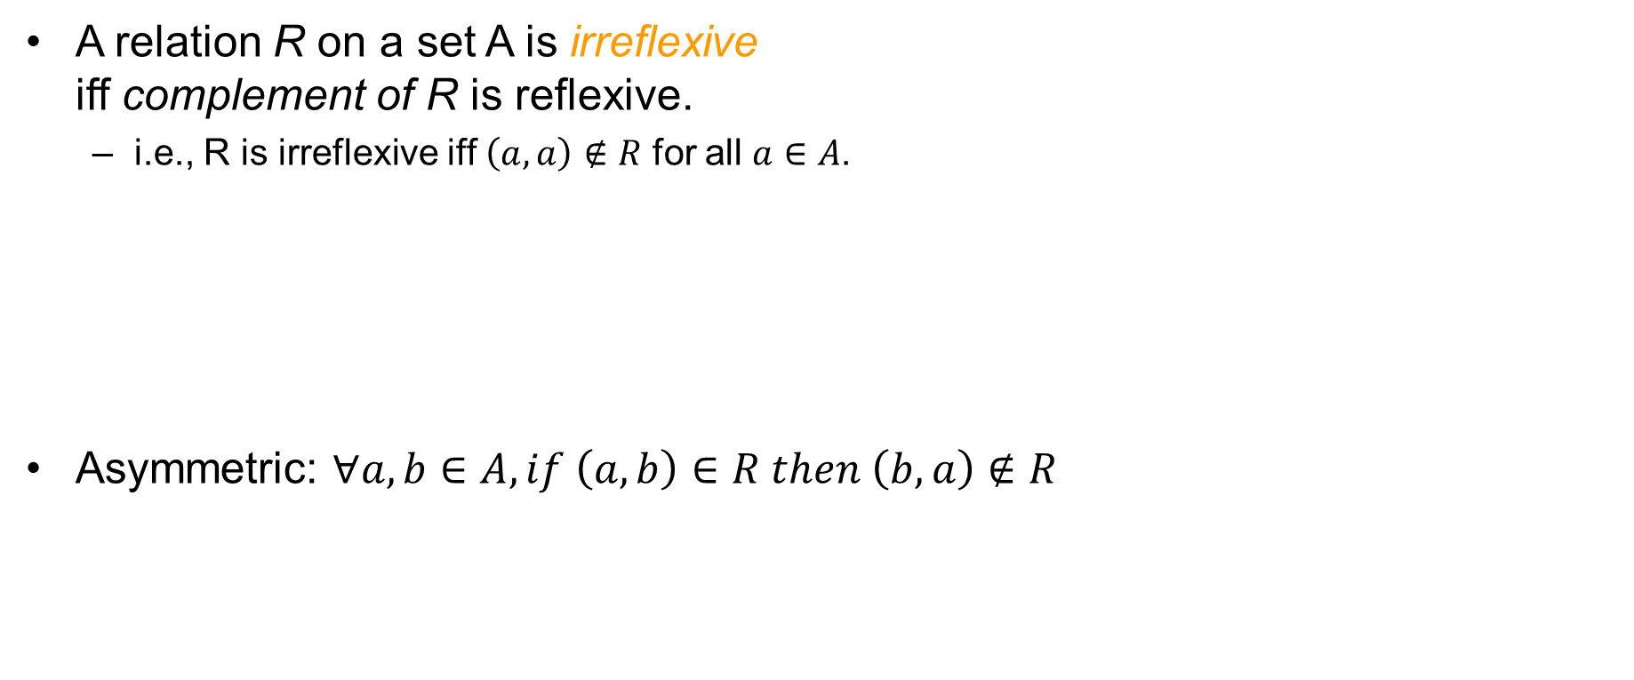
Some other relations
A relation R on a set A is irreflexive iff complement of R is reflexive.
i.e., R is irreflexive iff $\left(a, a\right)∉R$ for all $a∈A$.
Asymmetric: $∀a, b∈A, if \left(a, b\right)∈R then \left(b, a\right)∉R$

Slide 57
Combining Relations
Let A = {1, 2, 3} and B = {1, 2, 3, 4}. The relations R1 = {(1, 1), (2, 2), (3, 3)} and
R2 = {(1, 1), (1, 2), (1, 3), (1, 4)} can be combined to obtain
R1 ∪ R2 =
R1 ∩ R2 =
R1 − R2 =
R2 − R1 =

Slide 58
Composition of Relations
Let R be a relation from a set A to a set B and S a relation from B to a set C.
The composite of R and S is the relation consisting of ordered pairs (a, c), where a ∈ A, c ∈ C, and for which there exists an element b ∈ B such that (a, b) ∈ R and (b, c) ∈ S.
We denote the composite of R and S by S ◦ R.
Example: What is the composite of the relations R and S, where R is the relation from {1, 2, 3} to {1, 2, 3, 4} with R = {(1, 1), (1, 4), (2, 3), (3, 1), (3, 4)} and S is the relation from {1, 2, 3, 4} to {0, 1, 2} with S = {(1, 0), (2, 0), (3, 1), (3, 2), (4, 1)}?

Slide 59
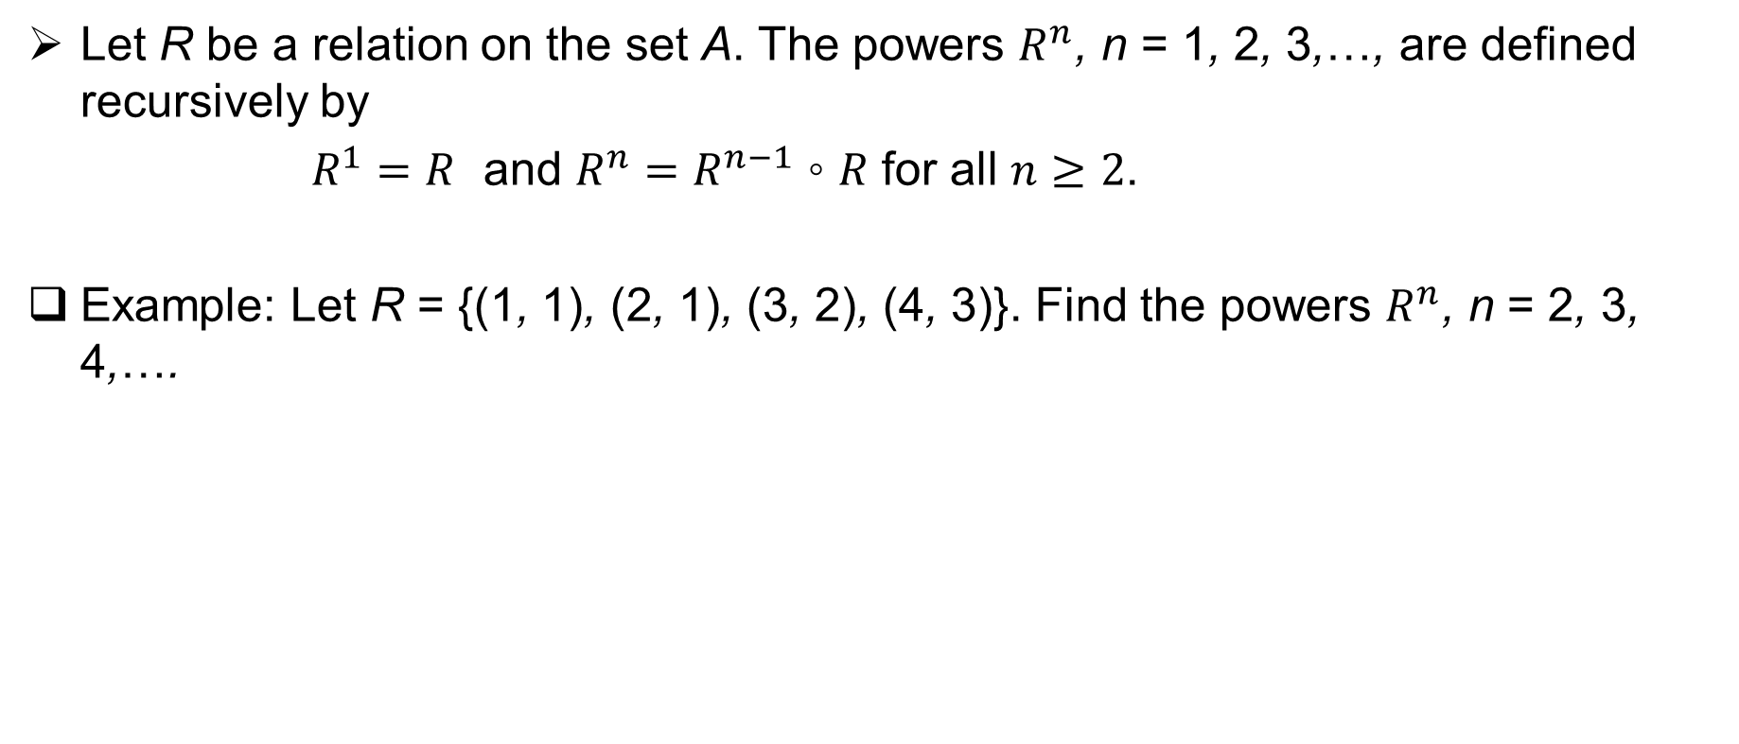
Powers of a relation
Let R be a relation on the set A. The powers $R^{n}$, n = 1, 2, 3,…, are defined recursively by
$R^{1}=R$ and $R^{n}=R^{n−1} \text{◦} R$ for all $n≥2$.
Example: Let R = {(1, 1), (2, 1), (3, 2), (4, 3)}. Find the powers $R^{n}$, n = 2, 3, 4,….

Slide 60
Thank You!!

